Slide 1
Pollynet Processing Program (version 1.0)
Pollynet
Processing
Program
Polly data
Figures
Meteor data
Retrieving Results (netcdf file)
AERONET data
Calibration results
(txt file)
history file
todo_listfile
Old versions of Polly are not supported yet !!!

Slide 2
PollyNET Data Processing Workflow
Polly Database
Data Preparation
Data Processing
Output
perl script
~/todo_filelist
~/recent_plots
polly_data.nc
fileinfo_new.txt
~/Pollynet_processing_chain
images
done_filelist.txt
PollyNET Processing Program
Extract unprocessed polly data
~/results
product .nc files
~ stands for ‘/pollyhome/Picasso’

Slide 3




Folder tree
20181011
pollyxt_lacros
20181012
pollyxt_tropos
20181013
recent_plots
done_filelist.txt

Slide 4
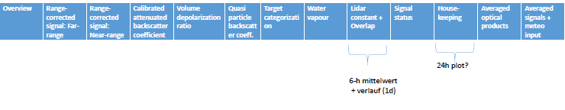
Navigation Bar
Blank area means no figures
pollyxt_lacros
Pollyxt_tropos
Pollyxt_fmi
Pollyxt_fmi
arielle
Pollyxt_dwd
Polly_1v2
pollyxt_IfT
pollyxt_1st
pollyxt_CGE
pollyxt_NIER

Slide 5
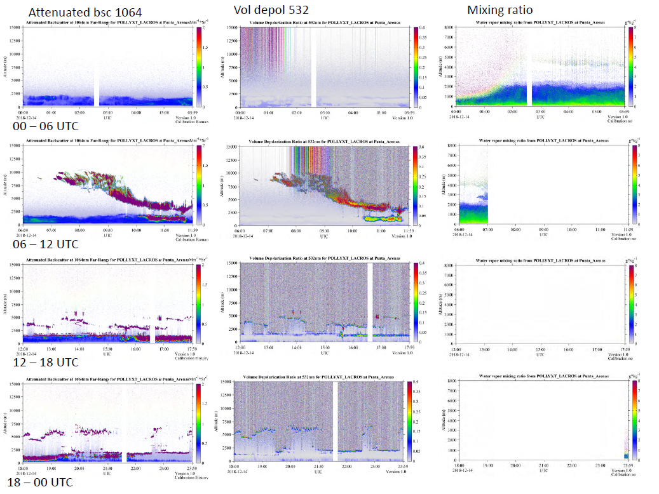
Overview

Slide 6
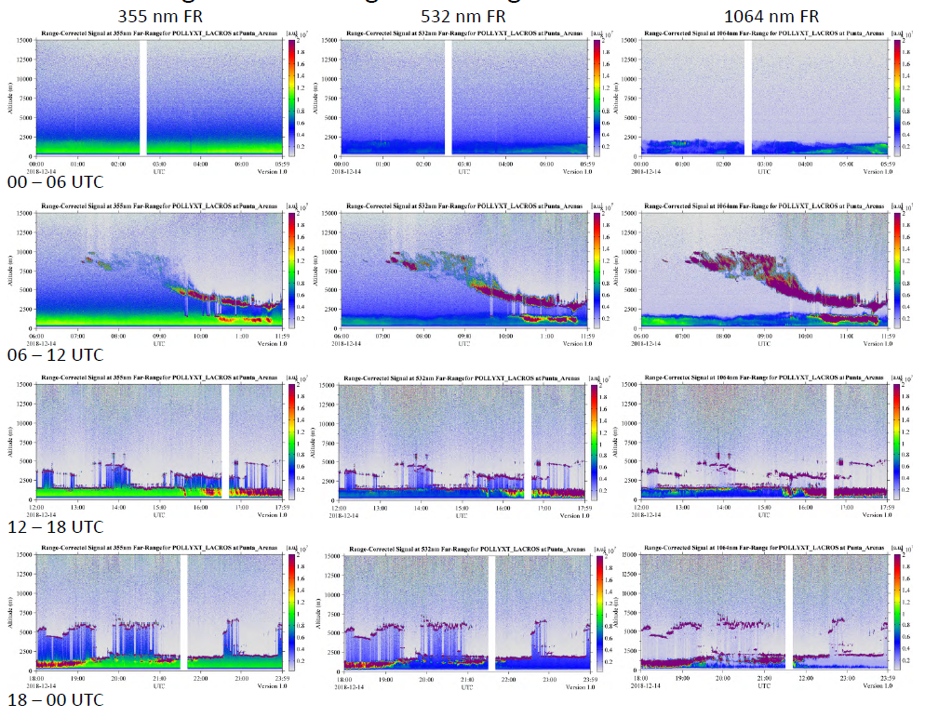
Range-Corrected Signal Far-Range

Slide 7
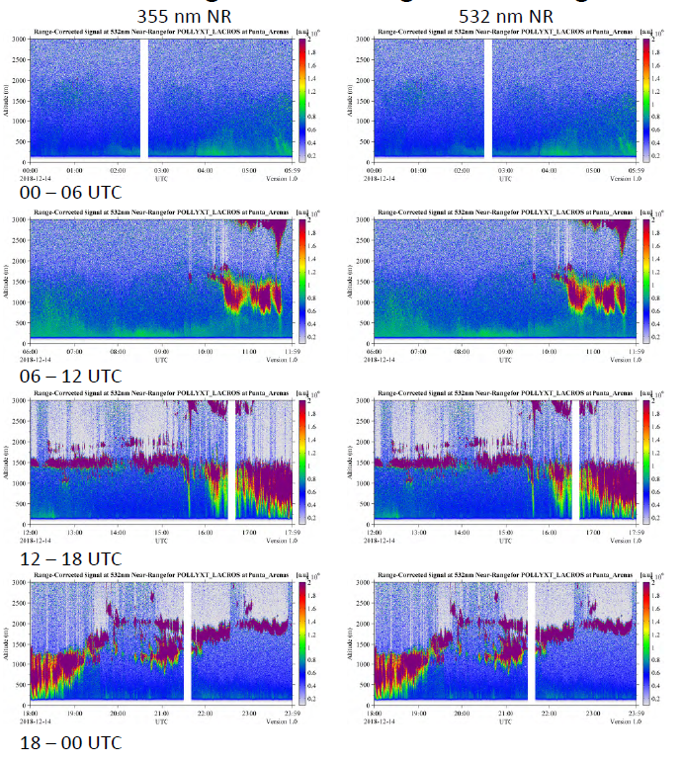
Range-Corrected Signal Near-Range

Slide 8
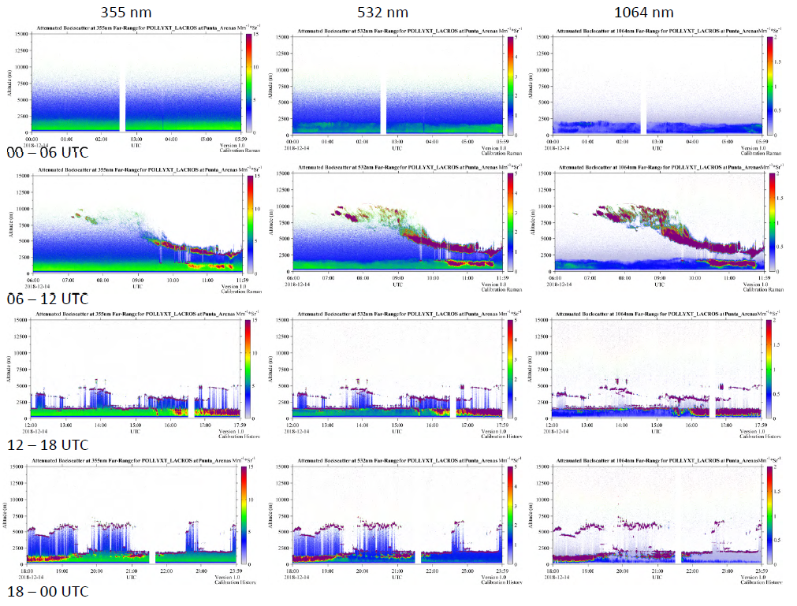
Attenuated backscatter

Slide 9
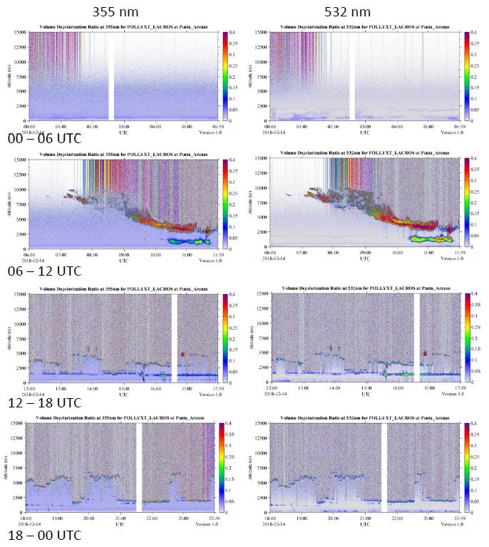
Volume depolarization ratio

Slide 10
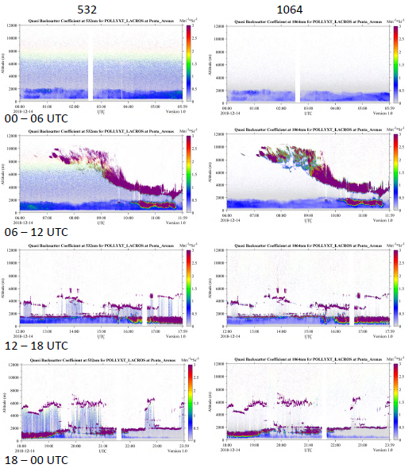
Quasi backscatter

Slide 11
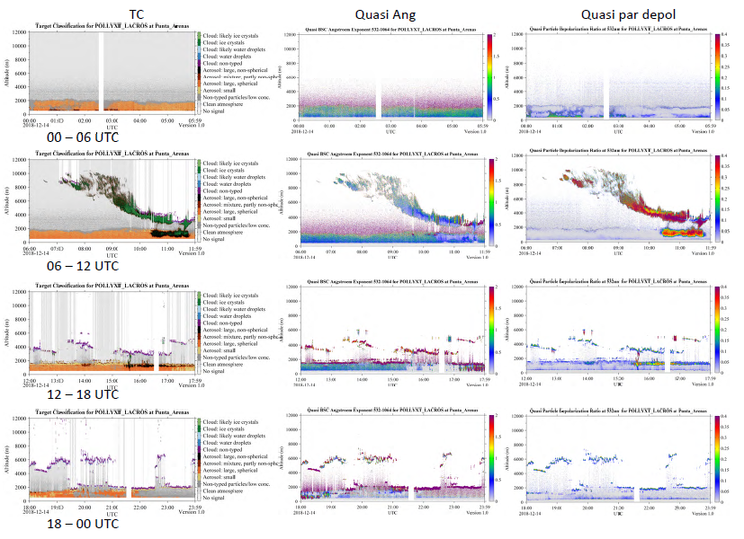
Target classification

Slide 12
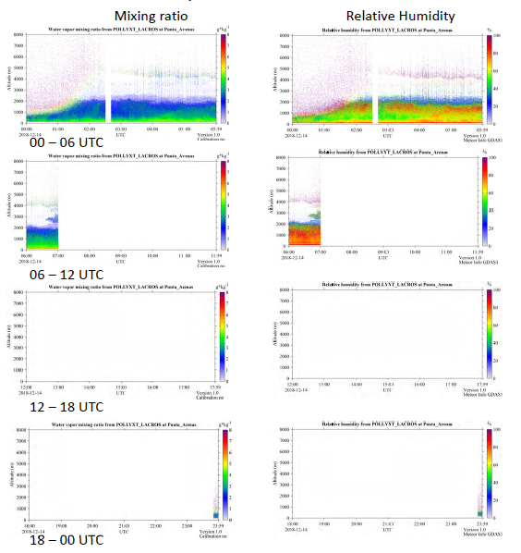
Water vapor mixing ratio

Slide 13
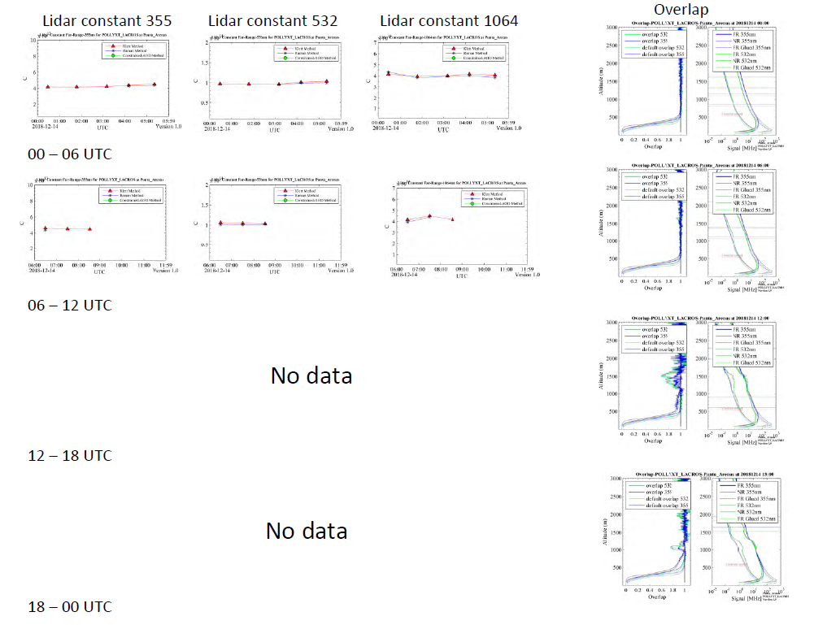
Lidar constant
There will be a blank figure here if there is no data

Slide 14
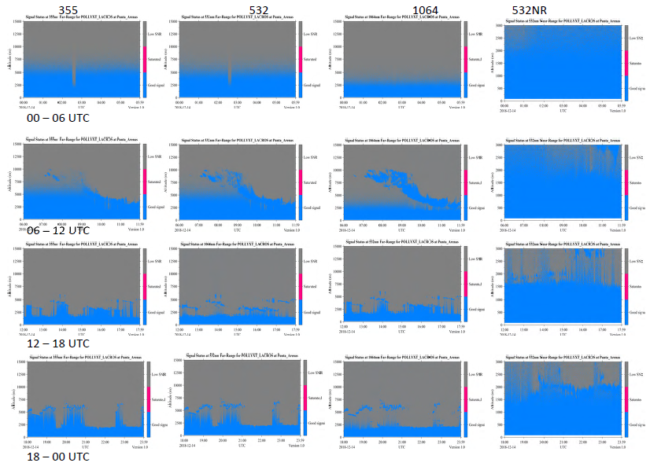
Signal status

Slide 15
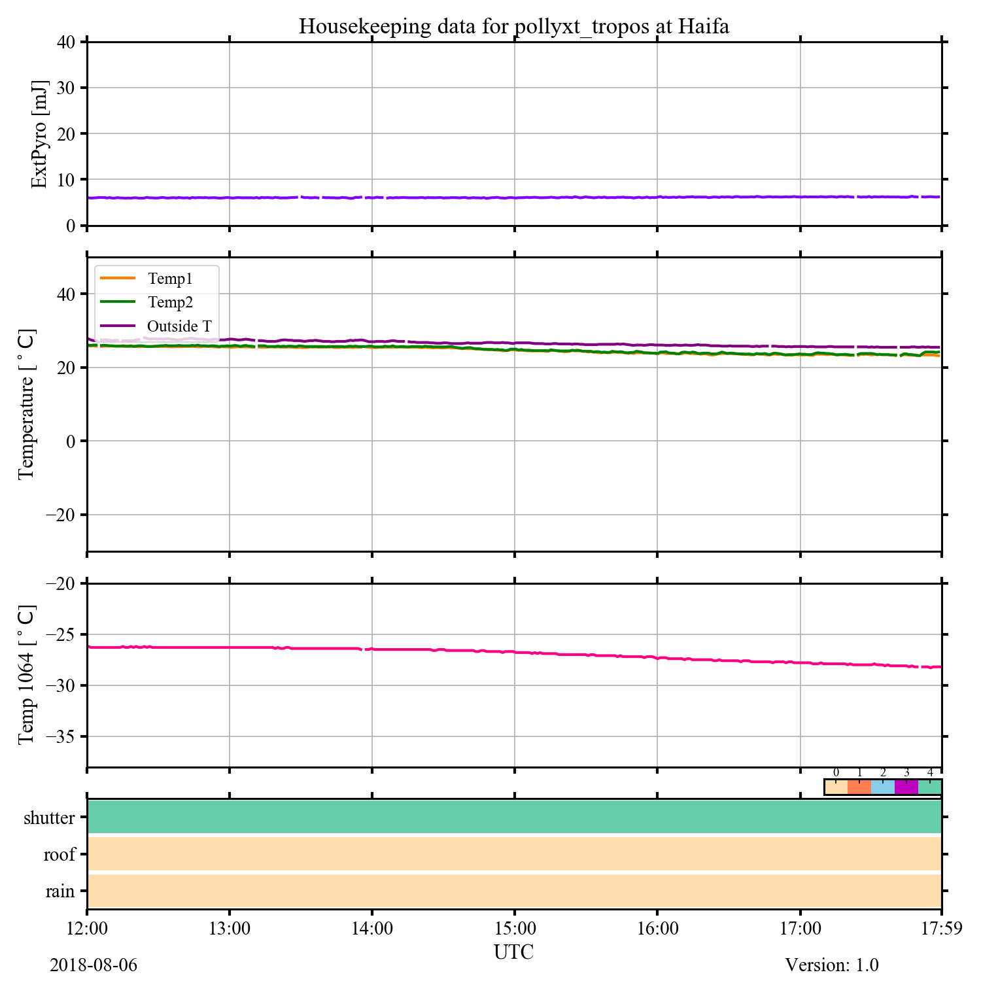
Housekeeping data

Slide 16
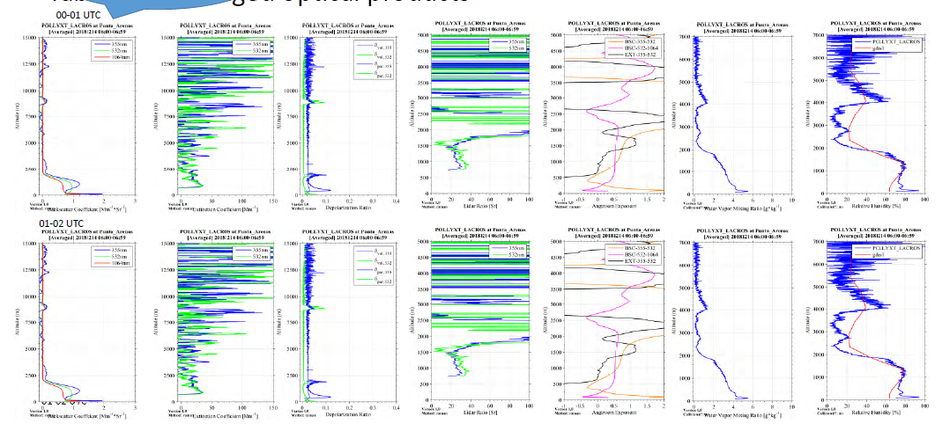
Averaged optical products
We have repeated figures both from Klett and Raman method.

Slide 17
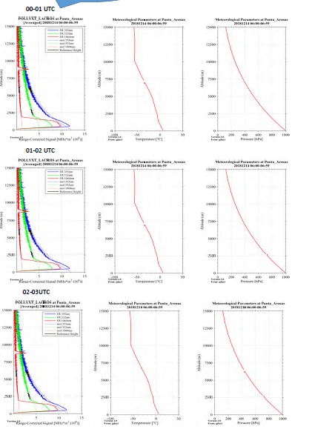
Meteor data and signal

Slide 18
Backup

Slide 19
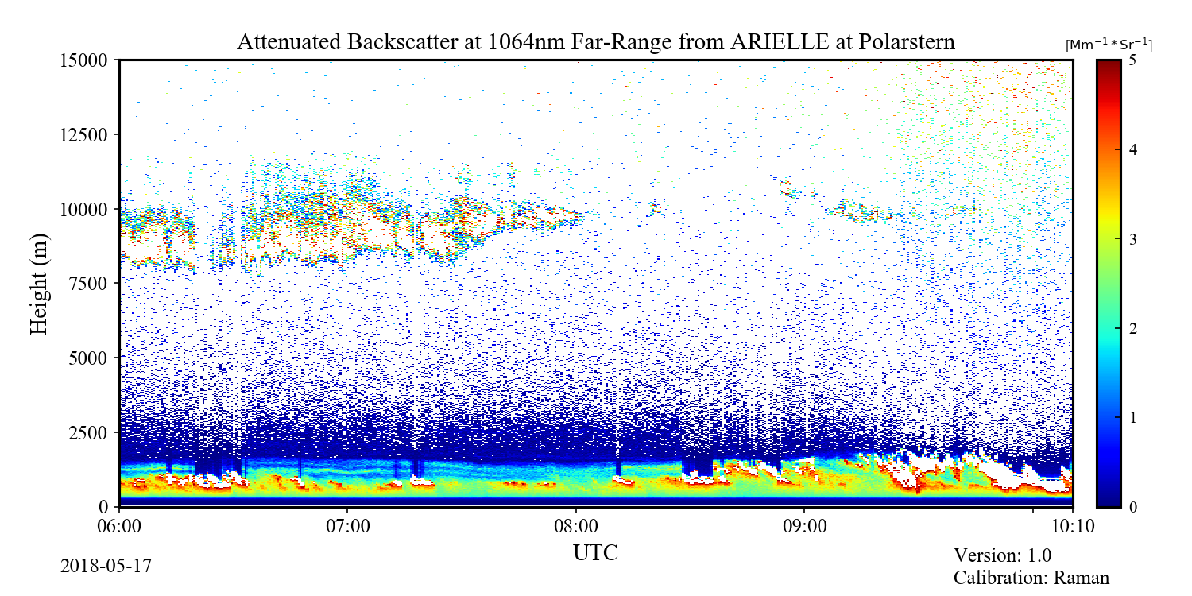
Figure Geometry – attenuated backscatter, vol depol, mixing ratio, RH, Range-Corrected signal near- or far-range, Quasi-* parameters, signal status
5 [a.u.]
10 [a.u.]

Slide 20
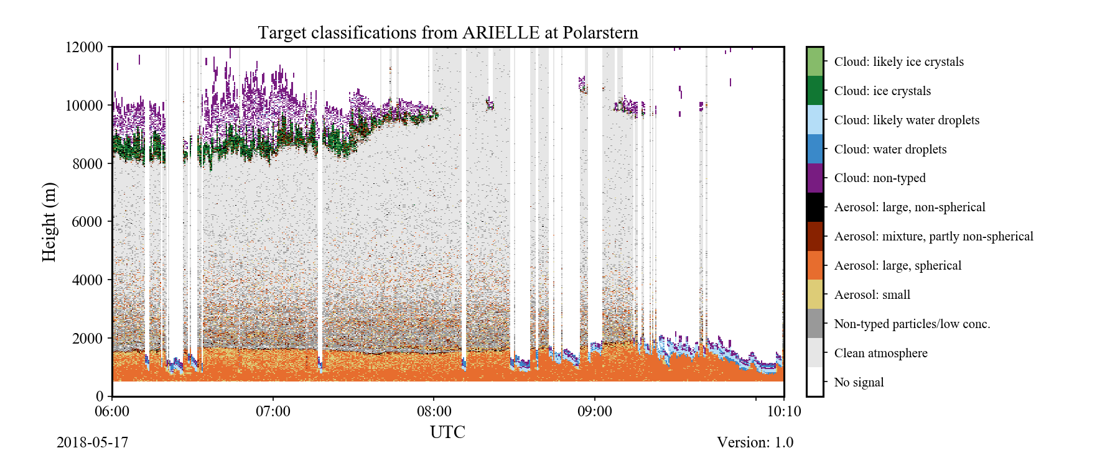
Figure Geometry – Target classification
5 [a.u.]
12 [a.u.]

Slide 21
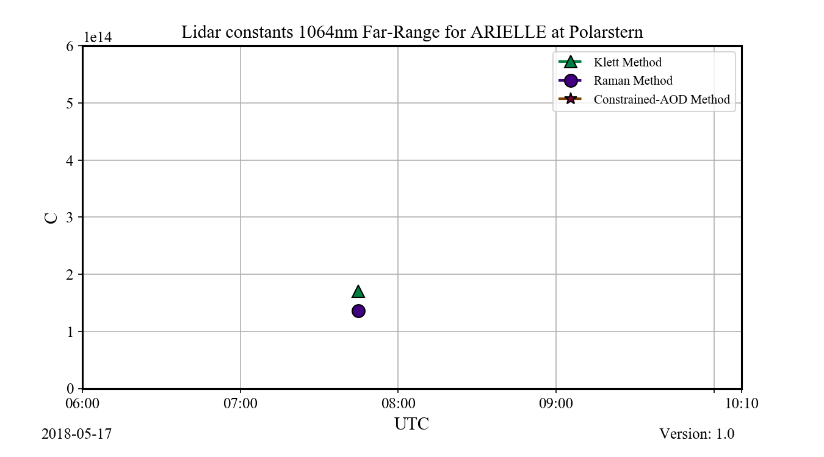
Figure Geometry – lidar constant
5 [a.u.]
9 [a.u.]

Slide 22
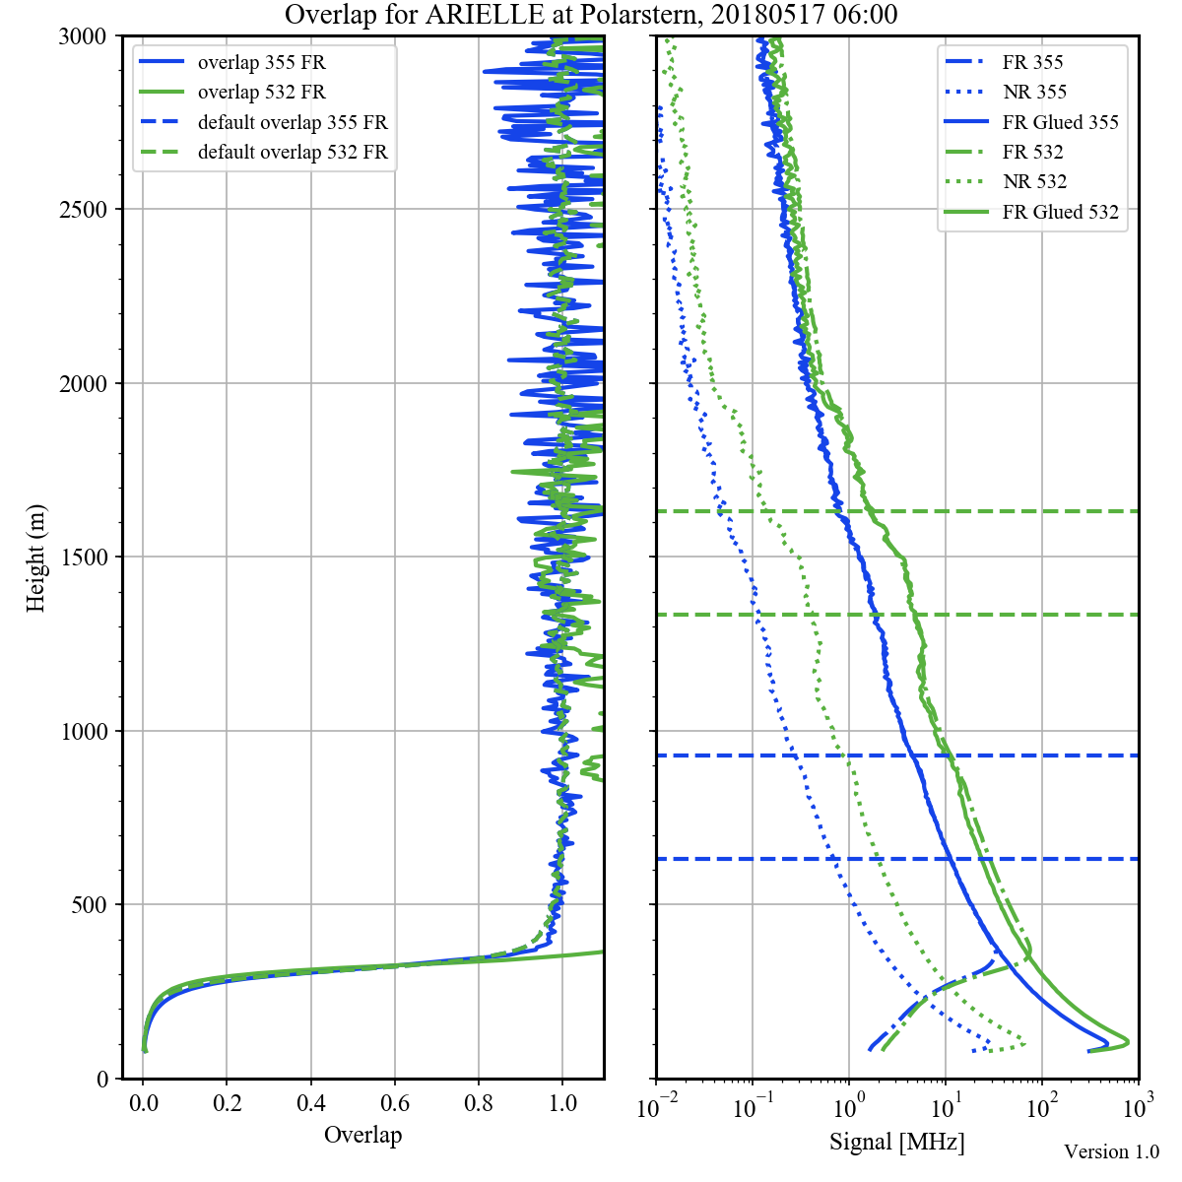
Figure Geometry – overlap
8 [a.u.]
8 [a.u.]

Slide 23
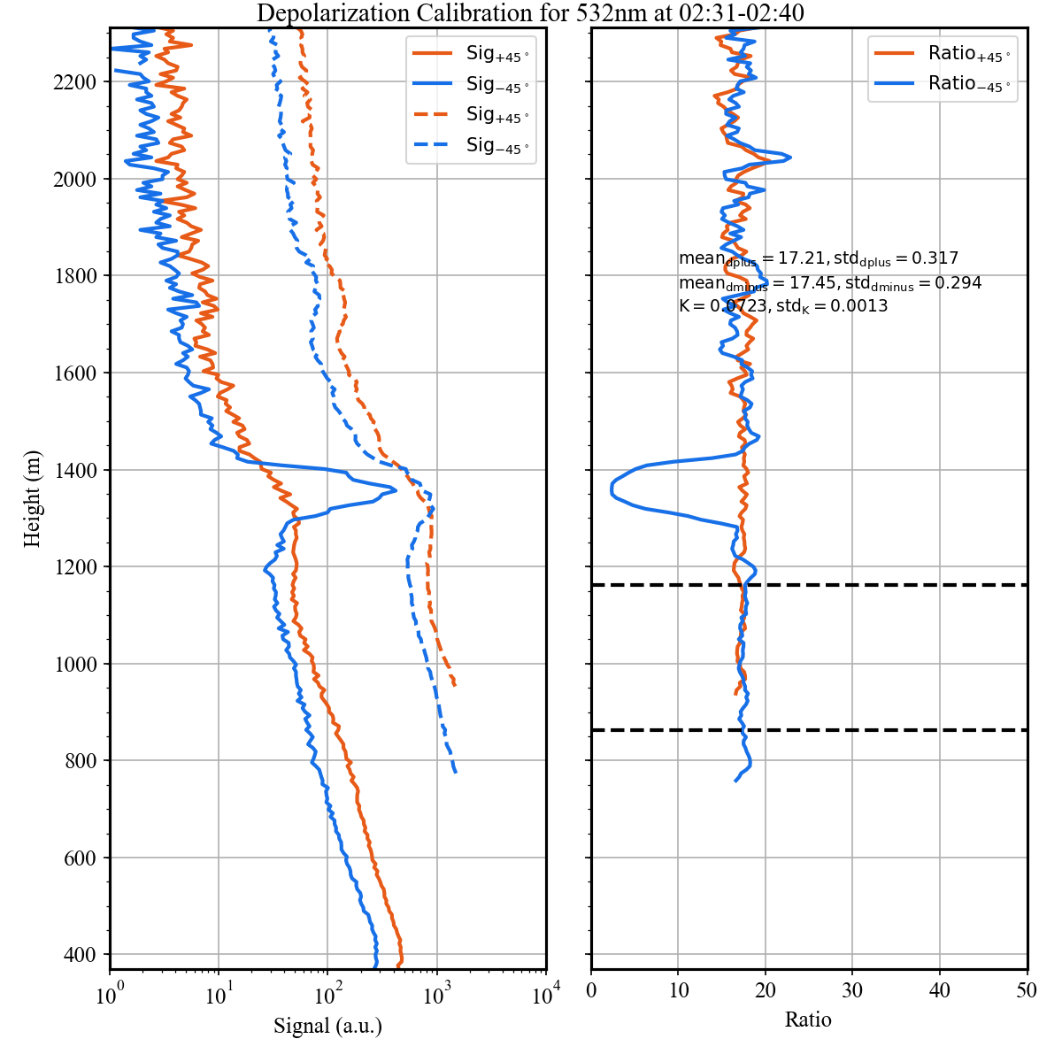
Figure Geometry – depolarization calibration
8 [a.u.]
8 [a.u.]

Slide 24
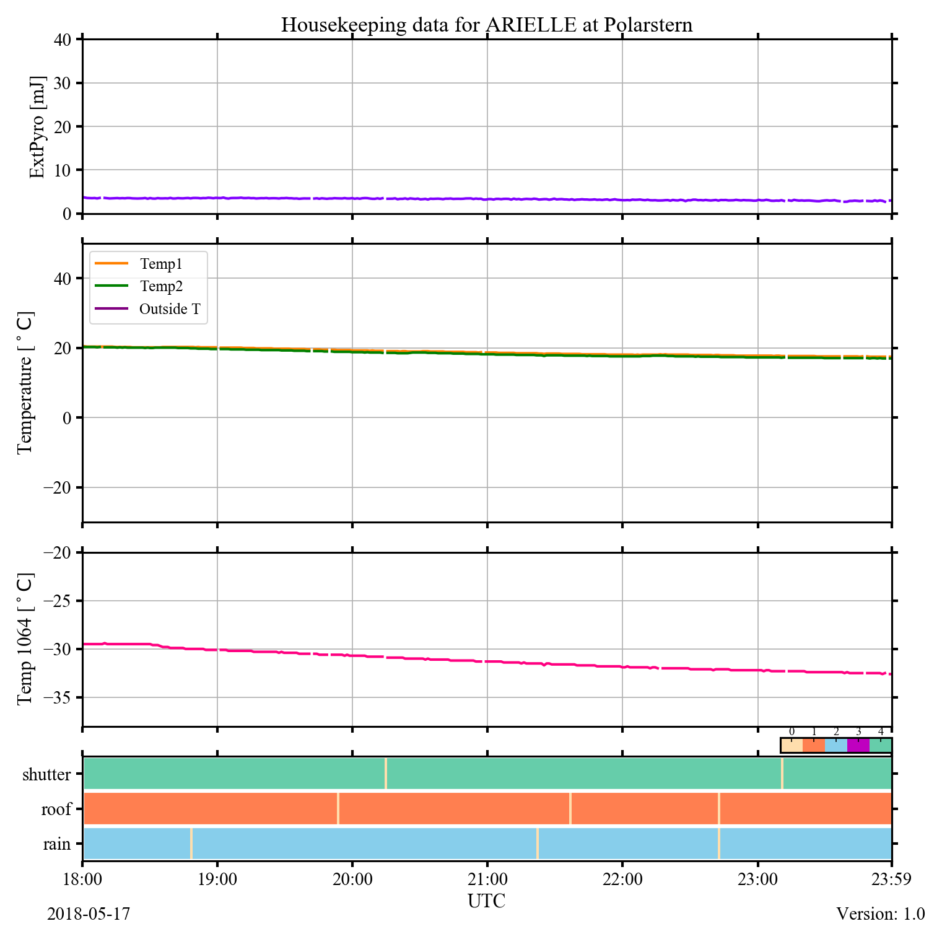
Figure Geometry – housekeeping
10 [a.u.]
10 [a.u.]

